Slide 1
Household income and a student’s SAT scores
Zach Childers, Youngjung Choi, Alexander San Filippo

Slide 2
Development Requirements
Use pandas to clean and format our dataset(s)
Create a Jupyter Notebook describing the Data exploration and cleanup Process
Create a Jupyter Notebook illustrating the final data analysis
Use Matplotlib to create a total of 6-8 visualization of our data
Save PNG images of our visualizations to distribute to the class and instructional team, and inclusion in our presentation
Create a write-up summarizing our major finding. This should include a heading for each “question” you asked of our data and a short description of our finding and any relevant plots
Project guideline

Slide 3



PROJECT PURPOSE & HYPOTHESIS
Is there a relationship between household income and a student’s success on the SAT?
Hypothesis: "There is a strong positive correlation between avg. household income and SAT scores.
Null Hypothesis: "There is no correlation between income and SAT scores"
+
=
?

Slide 4
DATA AND BACKGROUND
Background
Each states have different average SAT scores and household income.
We analyzed several databases to find answers:
College scorecard data from U.S Department Of Education:
AVG_SAT score, city, states, zip code,longitude and latitude.
US Census Data from 2018:
Household income, population and job occupation.
Combining two main database by city and states.
Present graph and scatter data. (include heat map)

Slide 5
DATA EXPLORATION AND CLEANUP
Combining two major data into one CSV file
Mainly used Vlookups (house income data’s city and state matches with SAT dataset)
Lat and Lon failures due to blank value
Elimination NaN values when combining house_income and SAT score data.
Dropna (pandas)

Slide 6
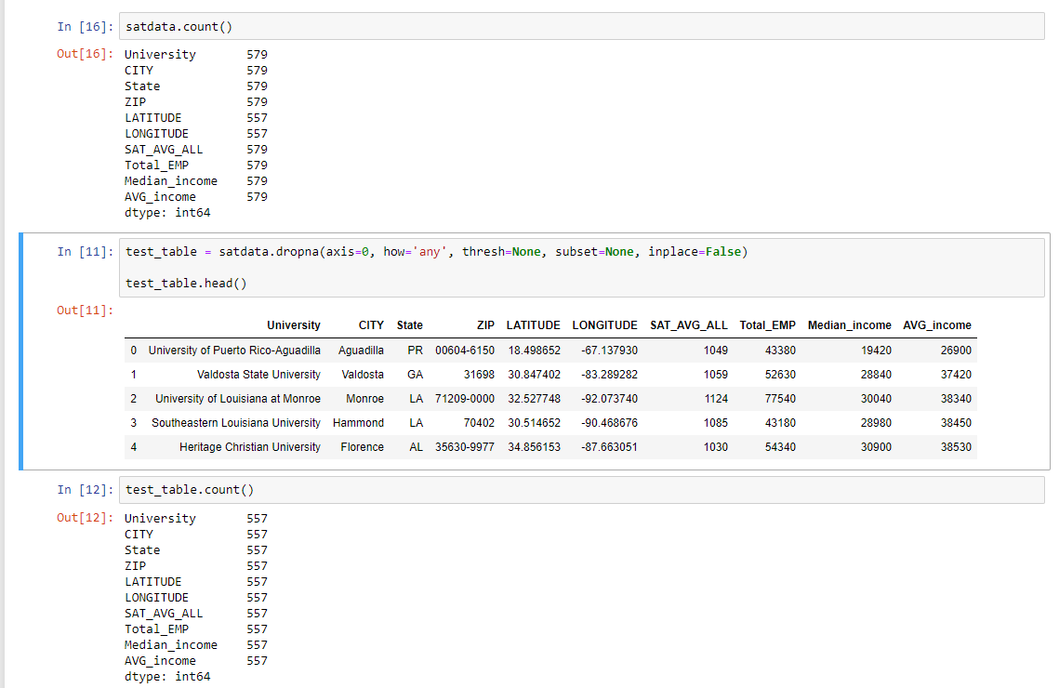
DATA EXPLORATION AND CLEANUP
Notes:
557 city throughout the entire US states

Slide 7
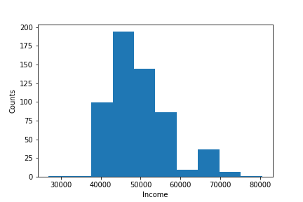
BACKGROUND BAR GRAPH
The lower quartile of income is: $44570.0
The upper quartile of income is: $53380.0
The interquartile range of income is: $8810.0
The the median of income is: $47750.0
The average income is: $49432
Values below $31355.0 could be outliers.
Values above $66595.0 could be outliers.

Slide 8
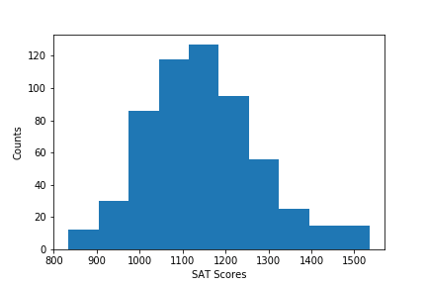
BACKGROUND BAR GRAPH
The lower quartile of SAT scores is: 1059.0
The upper quartile of SAT scores is: 1221.0
The interquartile range of SAT scores is: 162.0
The median of SAT scores is: 1134.0
The average SAT score is : 1147
Values below 816.0 could be outliers.
Values above 1464.0 could be outliers.

Slide 9
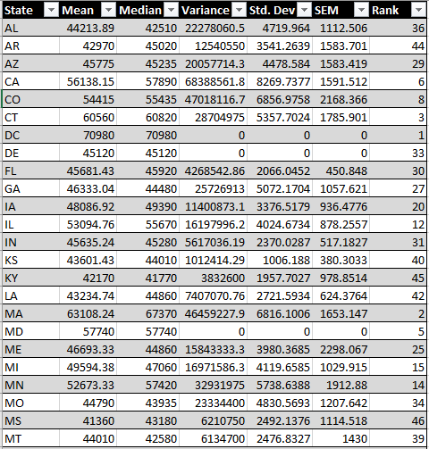
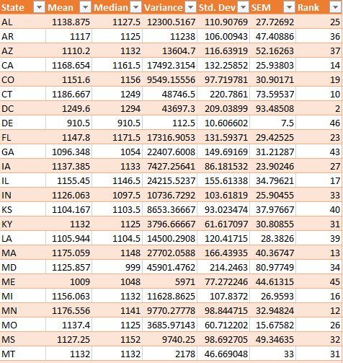
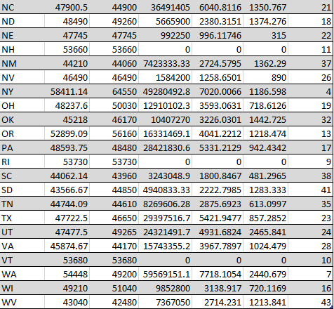
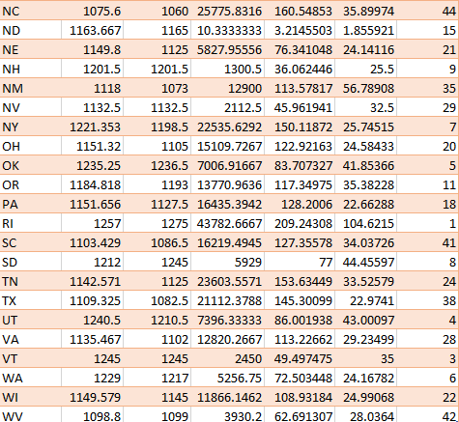
Household Income vs SAT scores by states
VS

Slide 10
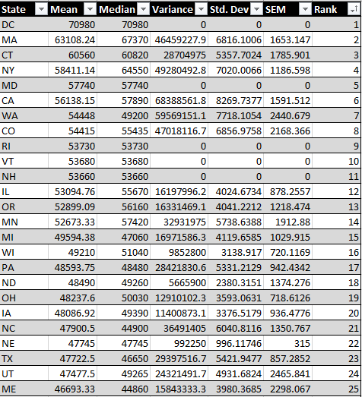
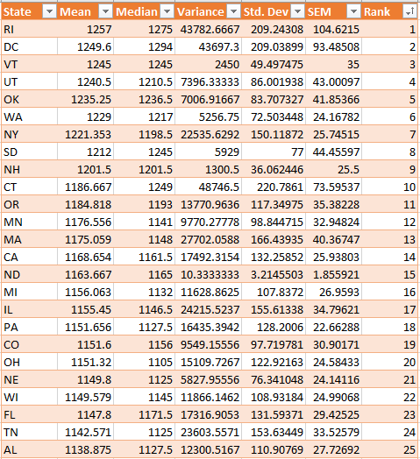
Top 25 Comparison Data Chart
VS

Slide 11
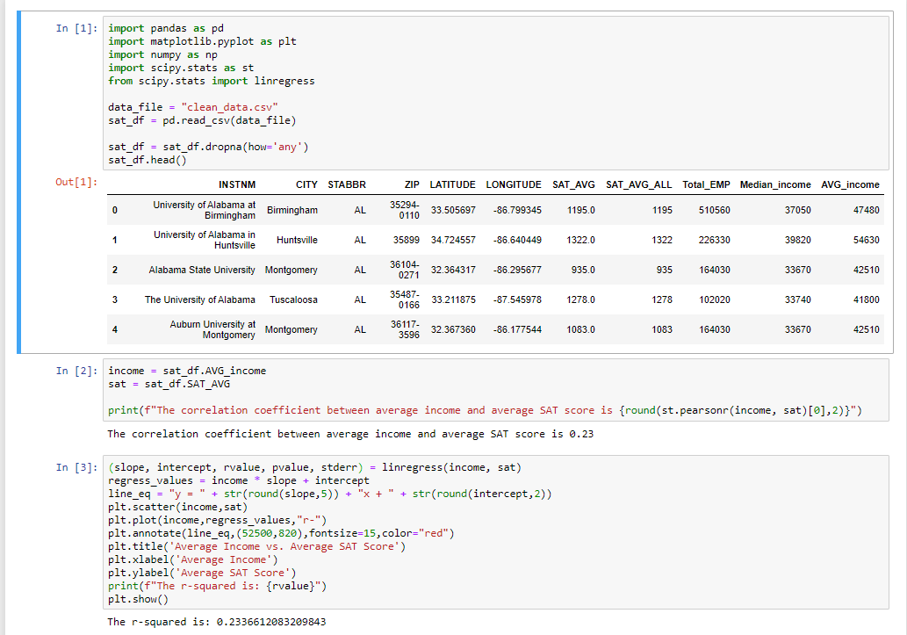
Scatter & Regression Chart

Slide 12
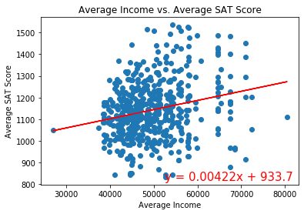
Scatter & Regression Chart

Slide 13
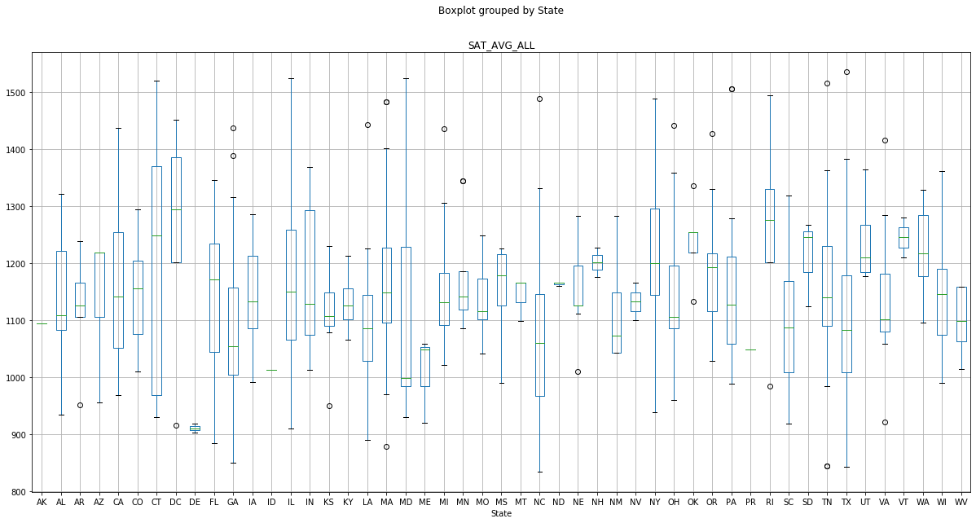
Avg. SAT BoxPlot Grouped by state

Slide 14
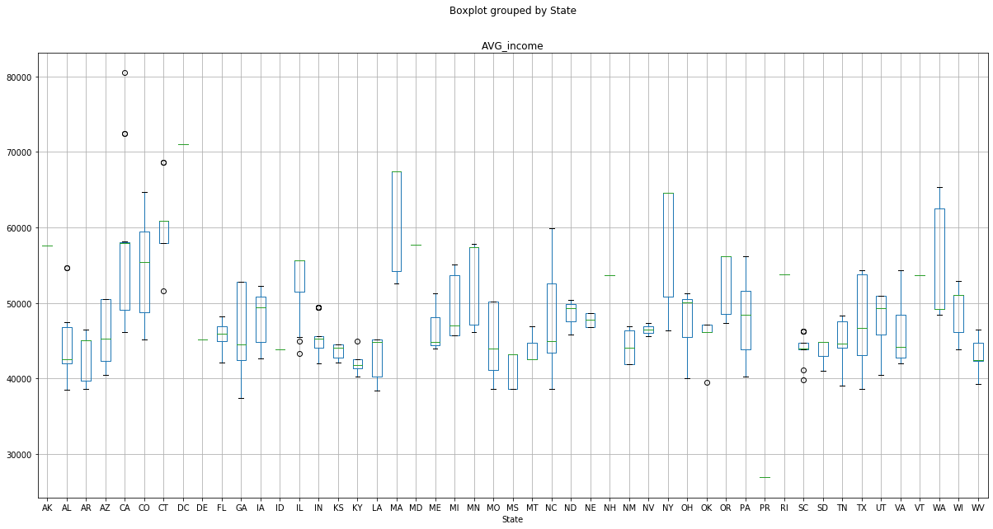
Avg. income BoxPlot Grouped by state

Slide 15
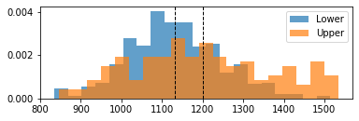
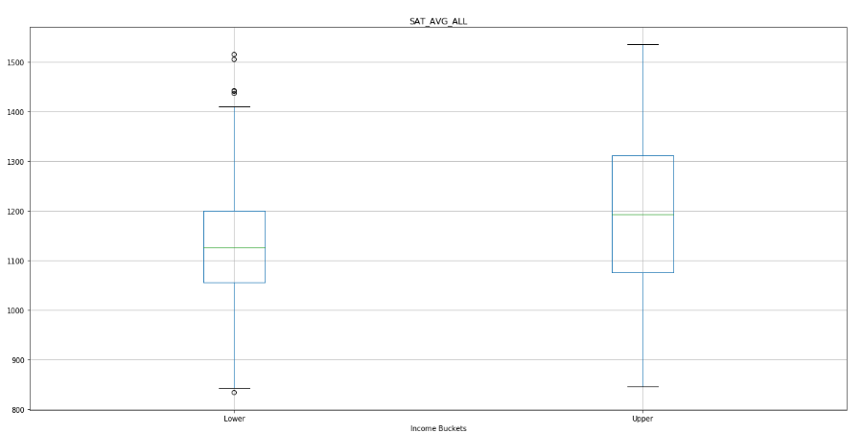
Lower vs Upper income comparison with SAT scores
Max income = $80480
Min income = $26900
Lower buckets = Income is lower than $53690
Upper buckets = Income is higher than $53690

Slide 16
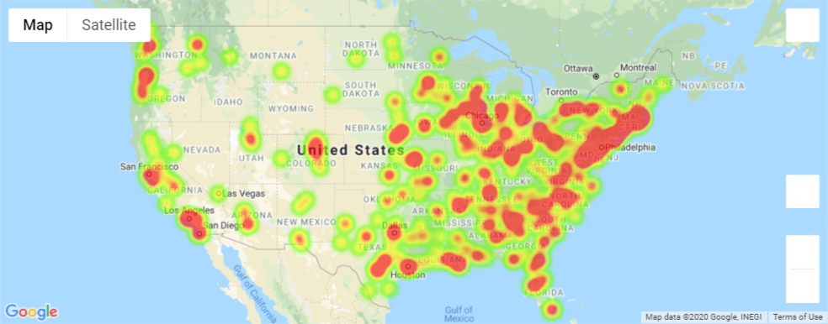
Heat map (income)

Slide 17
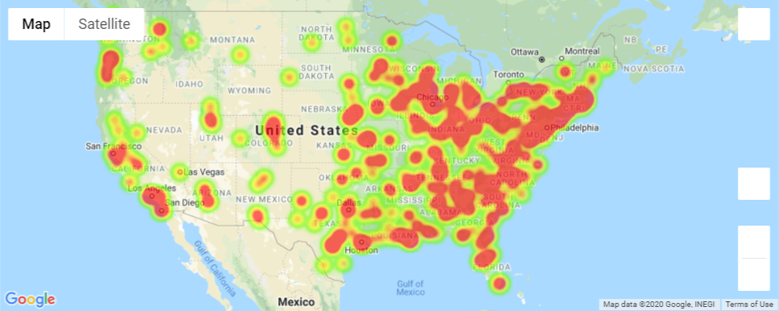
Heat map (SAT)

Slide 18
Major Observations & Ideas
Is there a relationship between household income and a student’s success on the SAT?
Hypothesis: "There is a strong positive correlation between avg. household income and SAT scores.
Null Hypothesis: "There is no correlation between income and SAT scores"
Although there is a positive correlation between average household income and SAT scores, with a correlation coefficient of 0.23, it is a decidedly weak positive correlation.
Although we can reject the null hypothesis based on these findings, we cannot accept the hypothesis that we started with. This indicates that it was framed too narrowly.

Slide 19
POST MORTEM
DIfficulties Experienced
It was difficult to request APIs server to obtain SAT and location database.
Additional ideas to improve
Gathering more data for income
Some of the data only has one or two input
Adding housing price or cost of living data APIs to backup data.

Slide 20

Questions & Answers

